Slide 1
CARBOHYDRATE METABOLISM
JIMI ADEJARE

Slide 2
INTRODUCTION
Carbohydrates are organic compound composed of carbon, hydrogen and oxygen.
they are essential macronutrients that provide a primary source of energy for body cells
TYPES
sugars
Starches
Fibers found in fruits vegetables, grains and legumes

Slide 3
Metabolism
Carbohydrate metabolism refers to the biochemical processes that involve the
breakdown,
synthesis,
and utilization of carbohydrates in living organisms.:

Slide 4
KEY ASPECT OF CARBOHYDRATE METABOLISM
Glycolysis
Gluconeogenesis
Citric acid (Krebs ) cycle
Oxidative phosphorylation
Glycogenesis
Glycogenolysis
Blood glucose regulation

Slide 5
Summary of carbohydrate metabolism
Carbohydrate metabolism involves several stages, primarily through processes like glycolysis, the citric acid cycle (Krebs cycle), and oxidative phosphorylation.
Glycolysis:
Occurs in the cytoplasm.
Glucose (a six-carbon sugar) is broken down into two molecules of pyruvate (a three-carbon compound).
ATP is consumed and produced during various steps.
Pyruvate Decarboxylation (Transition Reaction)
Pyruvate, produced in glycolysis, enters the mitochondria.
Each pyruvate molecule loses a carbon as CO2, forming acetyl-CoA.

Slide 6
Citric Acid Cycle (Krebs Cycle):
Takes place in the mitochondrial matrix.
Acetyl-CoA is further broken down, releasing CO2
transferring high-energy electrons to carrier molecules.
Produces NADH and FADH2, which carry electrons to the next stage.
Oxidative Phosphorylation (Electron Transport Chain and ATP Synthesis)
Involves the electron transport chain on the inner mitochondrial membrane.
Electrons from NADH and FADH2 move through the chain, creating a proton gradient.
ATP is synthesized as protons flow back into the mitochondrial matrix through ATP synthase.
Overall, these stages efficiently extract energy from glucose, storing it in the form of ATP
and reducing equivalents like NADH and FADH2. Keep in mind that the specifics can vary in different organisms and under different conditions.

Slide 7
Glycolysis:
Occurs in the cytoplasm.
Glucose is broken down into two molecules of pyruvate.
ATP and NADH are produced during glycolysis

Slide 8
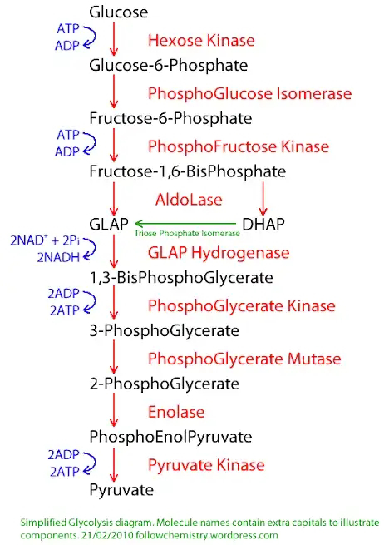

Slide 9
Gluconeogenesis:
Takes place in the liver and kidneys.
The synthesis of glucose from non-carbohydrate precursors (e.g., lactate, amino acids).
Important for maintaining blood glucose levels during fasting.

Slide 10
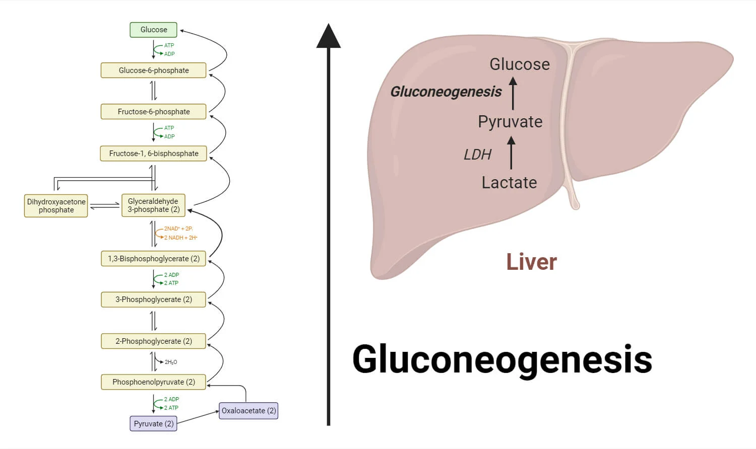

Slide 11
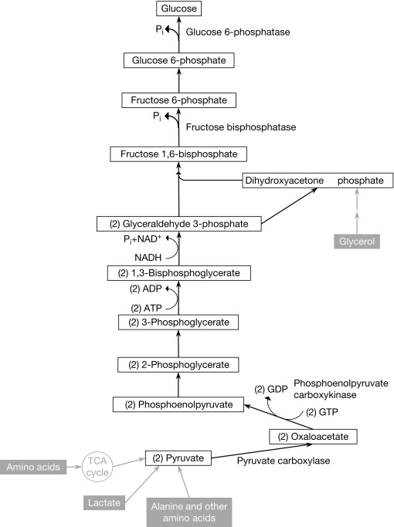

Slide 12
Citric Acid Cycle (Krebs Cycle):
Takes place in the mitochondria.
Acetyl-CoA (derived from glucose breakdown, fatty acid oxidation, or amino acid catabolism) enters the cycle.
Generates NADH, FADH₂, and ATP.

Slide 13
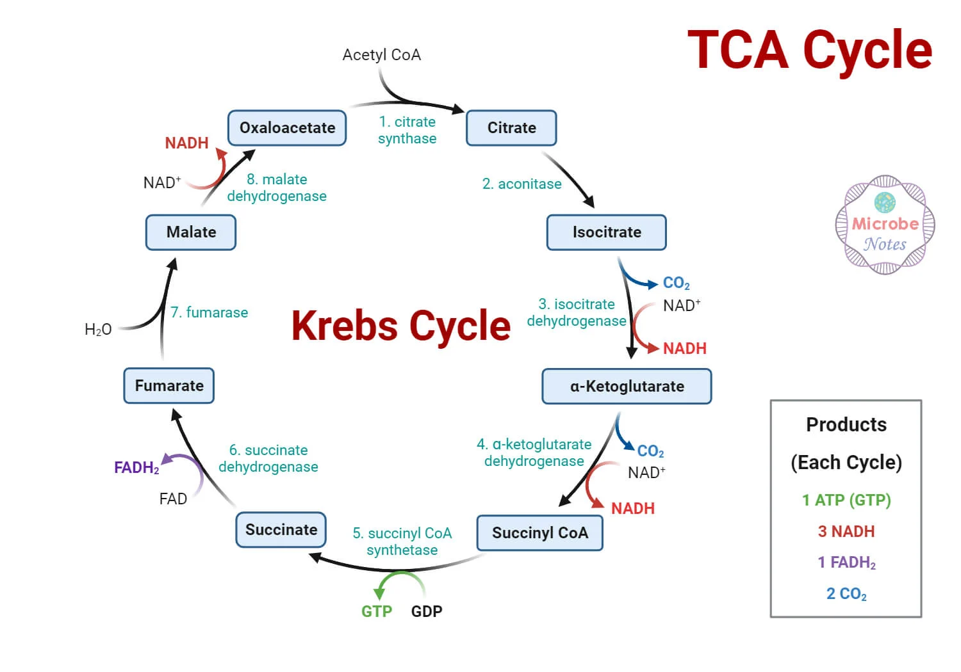

Slide 14
Oxidative Phosphorylation:
Involves the electron transport chain and chemiosmosis in the inner mitochondrial membrane.
NADH and FADH₂ donate electrons to produce ATP.
Oxygen is the final electron acceptor

Slide 15
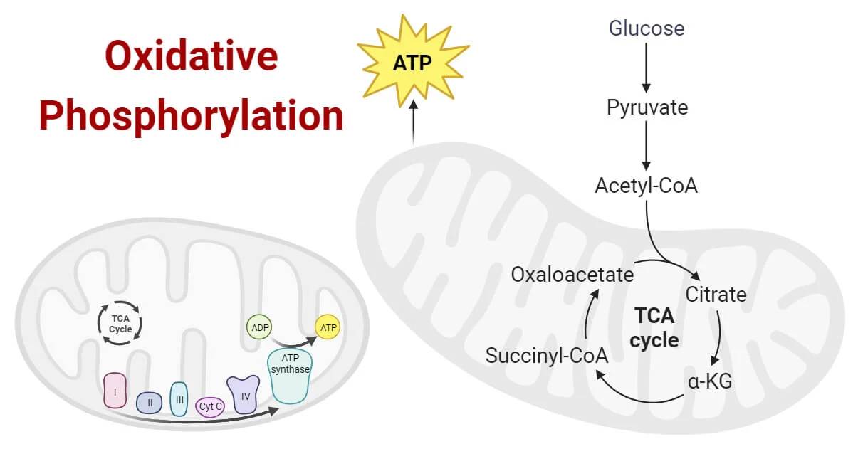

Slide 16
Glycogenesis:
The synthesis of glycogen from glucose.
Occurs in the liver and muscles.
Storage form of glucose.

Slide 17
Glycogenolysis:
Breakdown of glycogen into glucose.
Provides a rapid source of glucose for energy.
Important during periods of increased energy demand.
Hexose Monophosphate Shunt (Pentose Phosphate Pathway):
Runs parallel to glycolysis.
Generates NADPH for biosynthetic processes and produces ribose-5-phosphate for nucleotide synthesis.

Slide 18
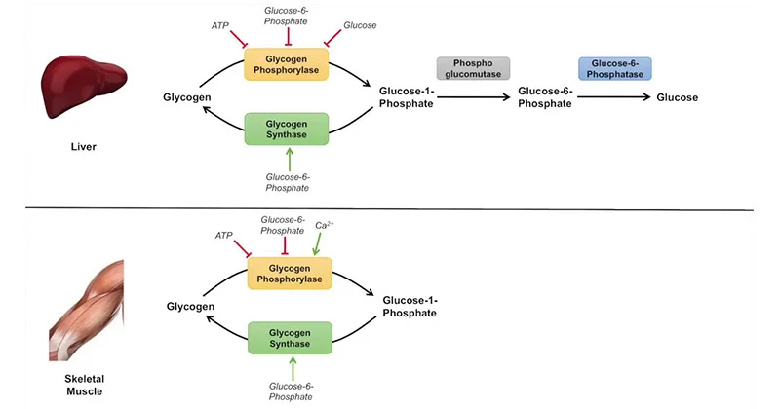

Slide 19
CONCLUSION
Dietary carbohydrates are a primary energy source.
Understanding carbohydrate metabolism is crucial for comprehending how cells derive energy,
maintain glucose homeostasis, and regulate various physiological processes.
Dysregulation in carbohydrate metabolism is associated with conditions like diabetes mellitus
and can have significant health implications.

